Slide 1


Lozan Chocolate Project
Ελληνο-Αλβανική Συμμαχία 2021

Slide 2
The team
Angela Demaj
Hermes Krouskos
Vasilis Kyrikos
Ferenc Shepllo
Nick Zouzoulas
Team Leader
Back End
Back End
Back End
Back End
Front End
Databases
Back End
Front End
Databases
Front End
Databases
Front End
Databases
Front End
Databases
Leaves/Roles
Warehouse Management
Recruitment
Products/ E-Shop
Payment

Slide 3
The Goal
Admin Dashboard
A modern approach to the Administration UI.
Modularity that allows the program to be adapted to any company.
User friendly with an intuitive environment.

Slide 4
The Goal
E-Shop
The simulation of a company for the sake of showcasing the capabilities of the Dashboard.
Demonstrates the bidirectional flow of the data between the interconnected projects.
A fully functional implementation of a modern E-Commerce solution.

Slide 5
The Technologies
Back End
.Net 5
Databases
SQL Server*
Front End
JavaScript*
AutoMapper
Autofac
EF Core
Swagger*
jQuery*
HTML*
CSS*
DataTables
Bootstrap*
ASP.NET Identity
*Technologies taught during the Bootcamp

Slide 6
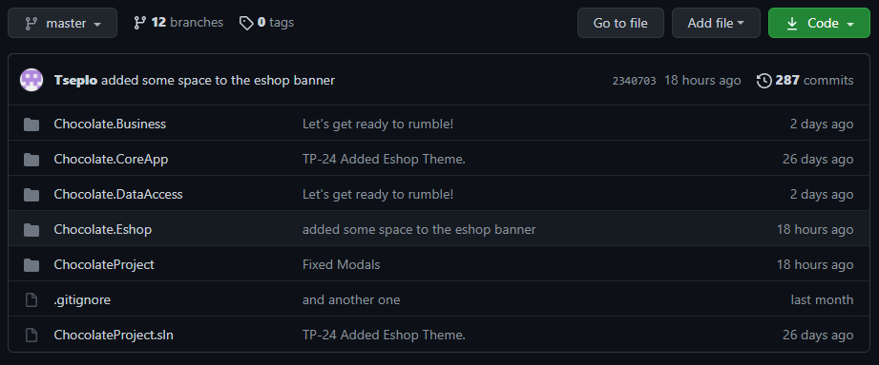
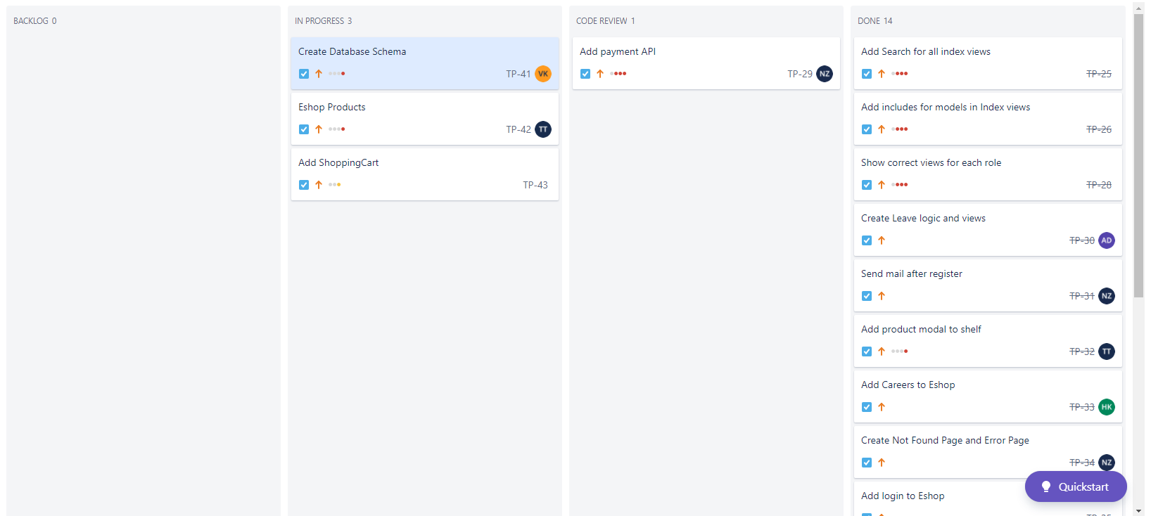
Project Management
GitHub
JIRA
And countless hours of conferences in Microsoft Teams

Slide 7
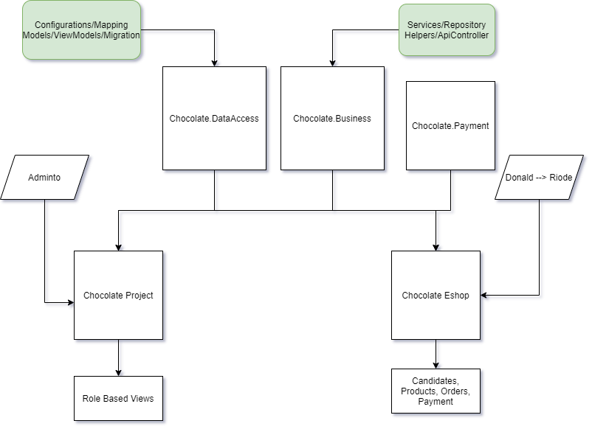

Slide 8
